Slide 1
Given odd number of students (n = 2k + 1) with 2D coordinates such that all distances are unique
Each student watches the student closest to him/her
Prove there is always at least 1 student that is not watched

Slide 2
Graph theory

Slide 3
Directed graph with odd number of nodes
Nodes = students
Edges = from watcher to watched
Every node has outdegree 1
Is there a node with indegree 0?

Slide 4
Ignore all weakly connected components with an even number of nodes
Only solution for weakly connected components with an odd number of nodes is a cycle of size n
Edges: v₀-v₁, v₁-v₂, … v_{n-2}-v_{n-1}, v_{n-1}-v₀
Since each student watches the closest student:
d(v_{i}-v_{i+1}) < d(v_{i}-v_{j}) ∀ i ∉ (i+1, j)
d(v₀-v₁) < d(v₀-v_{i}) ∀ i ∉ (0, 1)
d(v_{n-1}-v₀) < d(v₀-v₁) !
https://www.youtube.com/watch?v=3LYCjjYkdvo

Slide 5
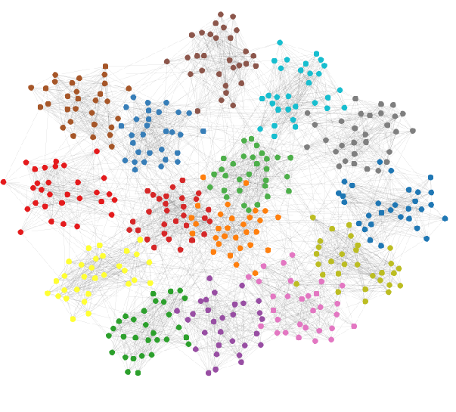
Communities in graphs
Groups of nodes that are closely connected
Neigbours update neighbours -> reinforcing loops
Finding communities is very hard
And communities can overlap

Slide 6
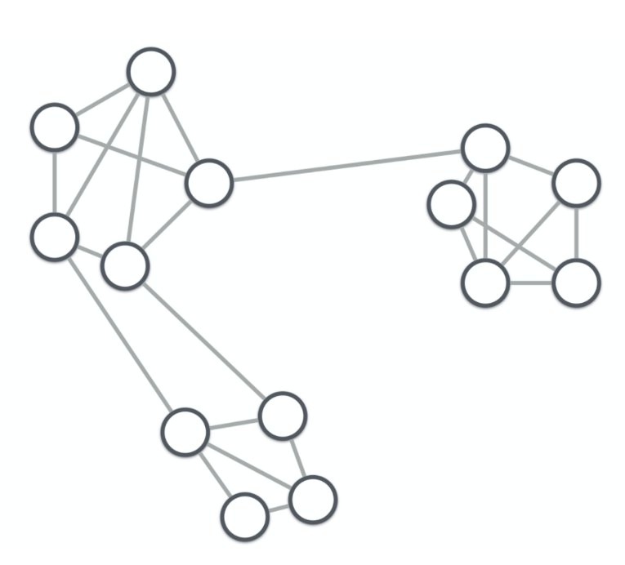
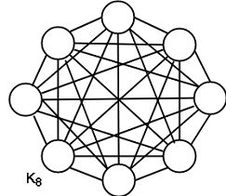
Communities?

Slide 7
Cliques
Ideal community: clique
"Complete graph as part of larger graph"
a clique of a graph G is an induced subgraph of G that is complete
Let G = (V,E) be any graph, and let S ⊂ V be any subset of vertices of G. Then the induced subgraph G[S] is the graph whose vertex set is S and whose edge set consists of all of the edges in E that have both endpoints in S. That is, for any two vertices (u,v) ∈ S, u and v are adjacent in G[S] if and only if they are adjacent in G

Slide 8
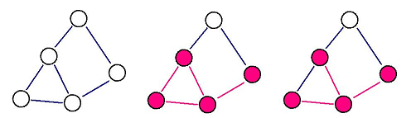
Induced subgraph
Let G = (V,E) be any graph, and let S ⊂ V be any subset of vertices of G. Then the induced subgraph G[S] is the graph whose vertex set is S and whose edge set consists of all of the edges in E that have both endpoints in S. That is, for any two vertices (u,v) ∈ S, u and v are adjacent in G[S] if and only if they are adjacent in G​

Slide 9
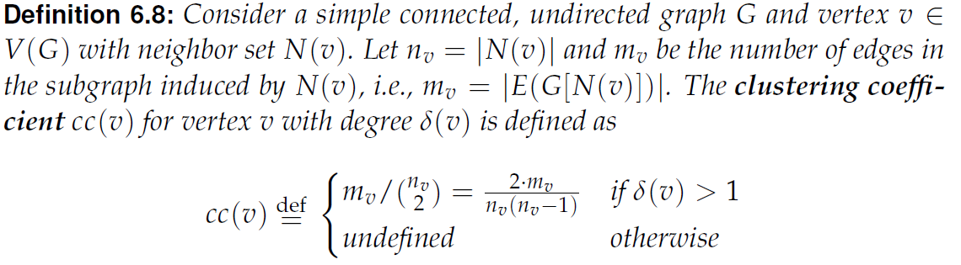
Clustering coefficient
What if there is no cliques?
To what degree are neighbours of v also neighbours of each other?
Used to show the existence of communities
This is a "local" view/definition: depends on nodes and their environment

Slide 10
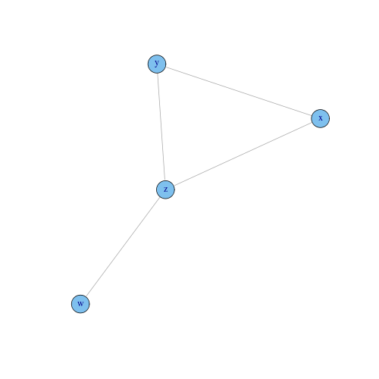
Global view on clustering coefficients
Network transitivity:
overall probability for the graph to have adjacent nodes interconnected
Number of triangles divided by number of triples
Triangle: xyz
Triples: wzy and wzx
For sufficiently large graphs:
Transitivity = avg(clustering coefficient)

Slide 11
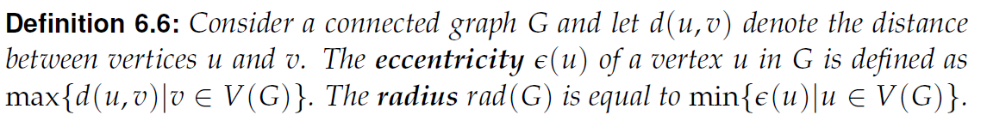
Centrality
Which nodes are in the middle of the graph
Eccentricity of node u: maximum distance from u to any other node
Vertex centrality: 1/eccentricity

Slide 12
Adjacency matrix
[[0, 1, 0, 1, 0, 0, 0, 0, 0, 0, 0, 0, 0, 0],
[1, 0, 1, 1, 0, 0, 0, 0, 0, 0, 0, 0, 0, 0],
[0, 1, 0, 1, 1, 0, 0, 0, 0, 0, 0, 0, 0, 0],
[1, 1, 1, 0, 0, 0, 0, 0, 1, 0, 0, 0, 0, 0],
[0, 0, 1, 0, 0, 1, 1, 0, 1, 0, 0, 0, 0, 0],
[0, 0, 0, 0, 1, 0, 1, 1, 0, 1, 0, 0, 0, 0],
[0, 0, 0, 0, 1, 1, 0, 1, 1, 0, 0, 0, 0, 0],
[0, 0, 0, 0, 0, 1, 1, 0, 1, 0, 0, 0, 0, 0],
[0, 0, 0, 1, 1, 0, 1, 1, 0, 0, 0, 0, 0, 0],
[0, 0, 0, 0, 0, 1, 0, 0, 0, 0, 1, 1, 0, 1],
[0, 0, 0, 0, 0, 0, 0, 0, 0, 1, 0, 1, 1, 0],
[0, 0, 0, 0, 0, 0, 0, 0, 0, 1, 1, 0, 1, 1],
[0, 0, 0, 0, 0, 0, 0, 0, 0, 0, 1, 1, 0, 1],
[0, 0, 0, 0, 0, 0, 0, 0, 0, 1, 0, 1, 1, 0]]
Recap: use a (square) matrix to describe a graph
0 = no edge
1 = edge
Alternative, use edge weight rather than 1
Free linear algebra!

Slide 13

Graph Laplacian
L = D – A
Where D is the diagonal matrix
Why? Because it has much nicer properties
[[ 2, -1, 0, -1, 0, 0, 0, 0, 0, 0, 0, 0, 0, 0],
[-1, 3, -1, -1, 0, 0, 0, 0, 0, 0, 0, 0, 0, 0],
[ 0, -1, 3, -1, -1, 0, 0, 0, 0, 0, 0, 0, 0, 0],
[-1, -1, -1, 4, 0, 0, 0, 0, -1, 0, 0, 0, 0, 0],
[ 0, 0, -1, 0, 4, -1, -1, 0, -1, 0, 0, 0, 0, 0],
[ 0, 0, 0, 0, -1, 4, -1, -1, 0, -1, 0, 0, 0, 0],
[ 0, 0, 0, 0, -1, -1, 4, -1, -1, 0, 0, 0, 0, 0],
[ 0, 0, 0, 0, 0, -1, -1, 3, -1, 0, 0, 0, 0, 0],
[ 0, 0, 0, -1, -1, 0, -1, -1, 4, 0, 0, 0, 0, 0],
[ 0, 0, 0, 0, 0, -1, 0, 0, 0, 4, -1, -1, 0, -1],
[ 0, 0, 0, 0, 0, 0, 0, 0, 0, -1, 3, -1, -1, 0],
[ 0, 0, 0, 0, 0, 0, 0, 0, 0, -1, -1, 4, -1, -1],
[ 0, 0, 0, 0, 0, 0, 0, 0, 0, 0, -1, -1, 3, -1],
[ 0, 0, 0, 0, 0, 0, 0, 0, 0, -1, 0, -1, -1, 3]]

Slide 14
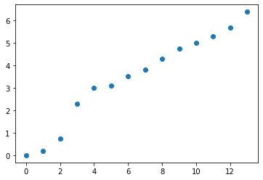
Spectral graph theory
Eigenvalues and eigenvectors of Laplacian
Smallest eigenvalue of L is 0
If there are n connected components in the graph, then there are n eigenvalues with value 0
First eigenvector (column) is constant
Sequence of eigenvalues indicator of (number of) communities
-0.000, 0.176, 0.729, 2.302, 3.000, 3.104, 3.515, 3.807, 4.298, 4.737, 5.000, 5.283, 5.671, 6.377
[[-0.26726124, -0.30898671, -0.455847 , 0.62690674, ...],
[-0.26726124, -0.29442565, -0.36140126, -0.12245337, ...],
[-0.26726124, -0.25330525, -0.14695614, -0.64548824, ...],
[-0.26726124, -0.26916601, -0.21778166, -0.06688793, ...],
...]

Slide 15
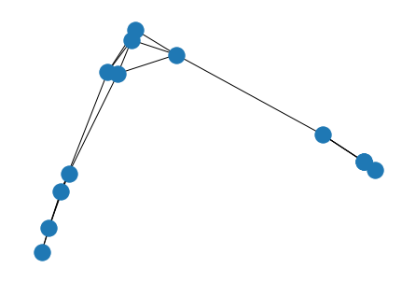
Spectral embedding
[[-0.26726124, -0.30898671, -0.455847 , 0.62690674, ...],
[-0.26726124, -0.29442565, -0.36140126, -0.12245337, ...],
[-0.26726124, -0.25330525, -0.14695614, -0.64548824, ...],
[-0.26726124, -0.26916601, -0.21778166, -0.06688793, ...],
...]
Use eigenvector columns as coordinates
2 columns for drawing, but can take n
Nx.draw_spectral, nx.spectral_layout

Slide 16
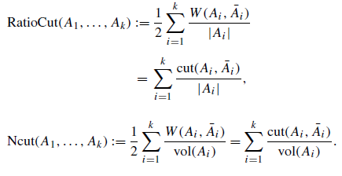
Graph partitioning
Divide graph into k sets of nodes
Vol(A): sum of all edge weights in subgraph induced by A

Slide 17
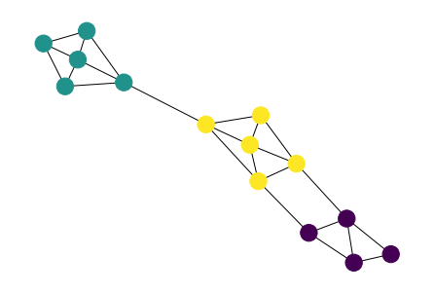
Spectral graph partitioning
Goal: minimize RatioCut (or NCut) for k partitions
NP hard problem!
Solve by :
Spectrally embedding G in k dimensions
Use e.g. k-means to cluster points into k clusters

Slide 18
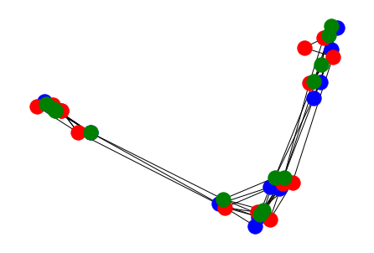

Spectrally embedding G in k dimensions
L = D – A, or...
Slightly different embeddings...
Unnormalized -> RatioCut, Normalized (sym or rw) -> NCut
Notes:
Blue embedding: not normalized;
Red embedding: L_sym
Green embedding: L_rw

Slide 19
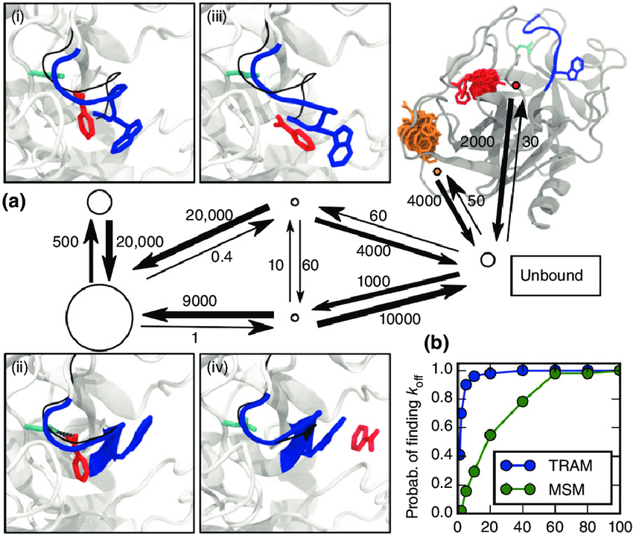
Markov modelling
Transitions between states
Transition chance only depends on current state (not past states)
Protein folding, drug binding, …
Is a directed graph!

Slide 20
Markov modeling
Is a directed graph!
Interested in “stable state” --- long-term probability that the system will be in each state
The “simple” way: from a starting state distribution, calculate inf transitions → x_{t} = x₀ P^{t}
The “smart” way: square of smallest eigenvector of normalized Laplacian

